Slide 1

MAGIST
DATA ANALYSIS
HELD ON 04.07.2024
PRESENTED BY : Hyoeun
Sanyuja
Kizita

Slide 2
CONTENT:
In-Depth Analysis of Tech Item in Magist
User growth in Magist
Delivery and Customer reviews

Slide 3
In-Depth Analysis of
Tech Item in Magist

Slide 4
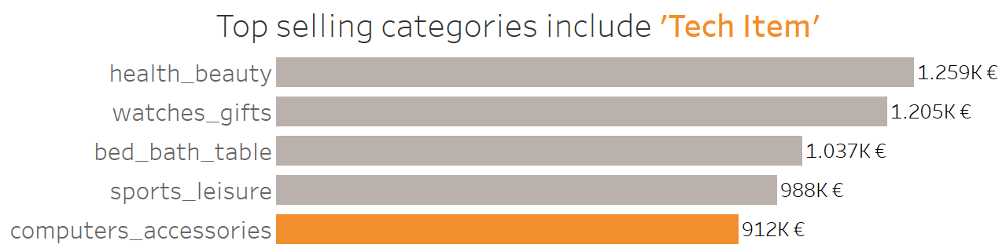
Period: Sep. 2016 - Oct. 2018
Only 9.6% of the total revenues from ‘Tech Item’
This is a rather tiny share of Magist’s sales

Slide 5
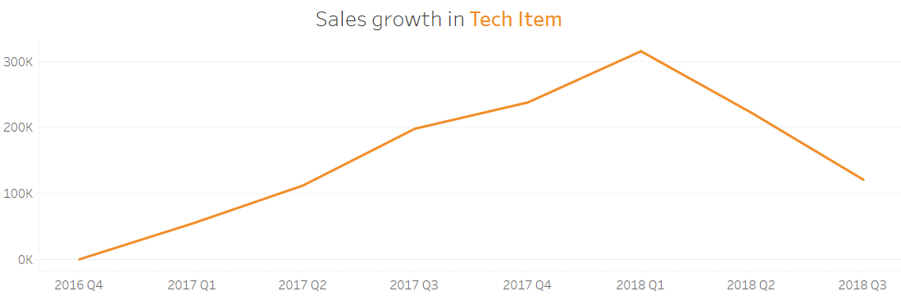
Since 2018, Sales growth in Tech Items has significantly decreased.
This downward trend raises concerns.

Slide 6
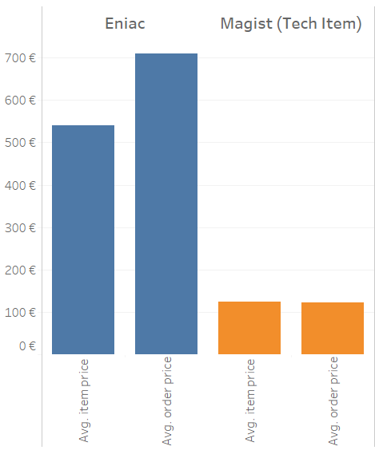
Eniac vs. Magist
Item & Order price Comparison:
Eniac’s average price are substantially higher than Magist’s price range.
It raises concerns about security and handling high-value products
Period: Apr. 2017 - Mar. 2018

Slide 7

2. User growth in Magist

Slide 8
USER GROWTH IN MAGIST:
From 2016 to 2018, smart appliances experienced a significant increase in the database, with exponential growth observed across all life sectors.
From 2016 to 2018, the growth was influenced by the following purchase styles:
Delivered - 96478
Shipped - 1107
Canceled - 301
This 3 has the most number of purchase style items.

Slide 9
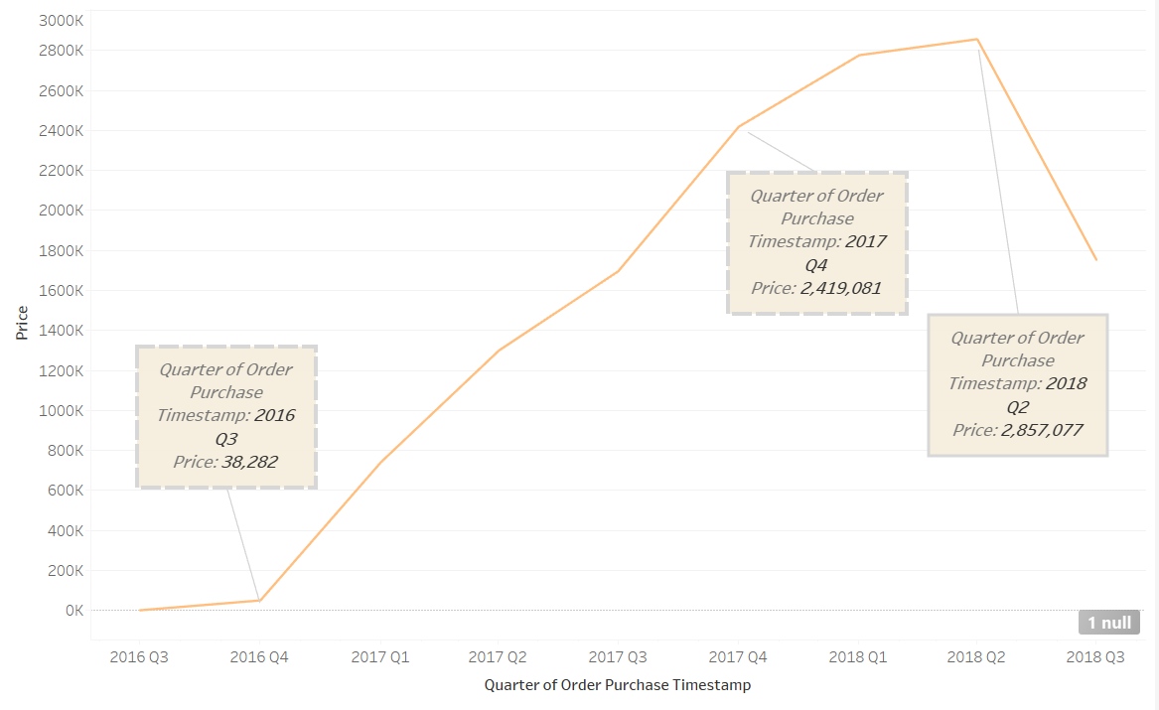

Slide 10
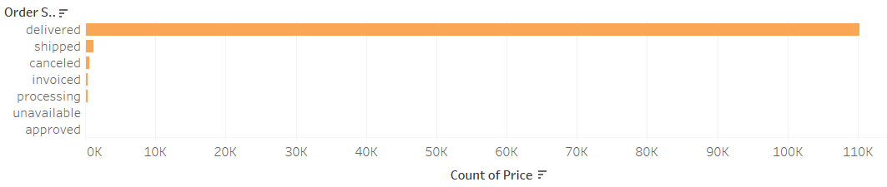
Delivery ranks 1st as order status:
The total cost of delivered items is 1,10,197 €, shipped items are 1,185 €, and canceled items are 542 €.

Slide 11
3. Delivery and Customer reviews

Slide 12
Delivery specifications:
Avg. Delivery time: 13 days
3 days faster than the average 16 days* in Brazil
Avg. Delivery fee: 18.90€
* Statista (Average delivery time for an online order in Brazil)

Slide 13
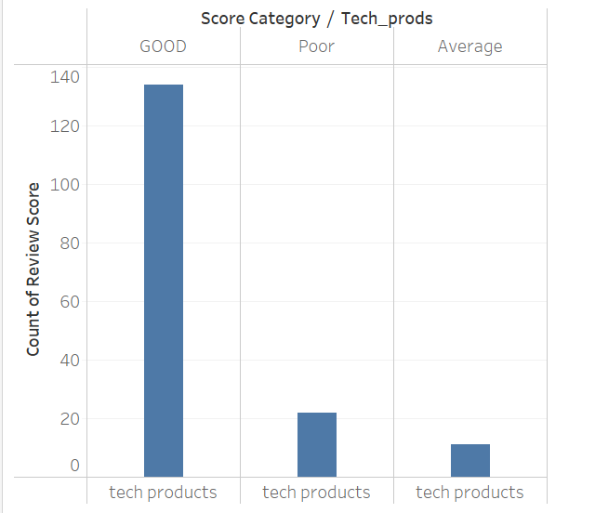
Vast Majority on Positive Reviews:

Slide 14
KEY INSIGHTS:
POSITIVE
User growth improved (2+ years)
Delivery time faster than average
Positive Customer reviews
NEGATIVE
Small share of ‘Tech item’
Lack of High-value product experience
Eniac would not be beneficial from a partnership with Magist.

Slide 15

THANKYOU

